Slide 1
Xamarin Forms Android and IOS Mobile App Development With C#
Jon Worthington
October 8, 2019

Slide 2
What we will be covering
This presentation will mainly be a coding demo
We will be using C# to build a cross platform Android and iOS application
We will spend 5 minutes showing the final application we will be building
We will spend 5 minutes for slides introducing Xamarin Forms
The remaining time will be spent in C# creating the Demo Racquetball Score Keeper Application for iOS and Android
We may go a few minutes long – if we do feel free to leave if you need to. But lunch is next – so you shouldn’t miss your next class if you decide to stay.

Slide 3
Racquetball Score Keeper
https://rbscorekeeper.azurewebsites.net https://rbscorekeeper.azurewebsites.net/stats https://rbscorekeeper.azurewebsites.net/swagger
Show Phone App

Slide 4
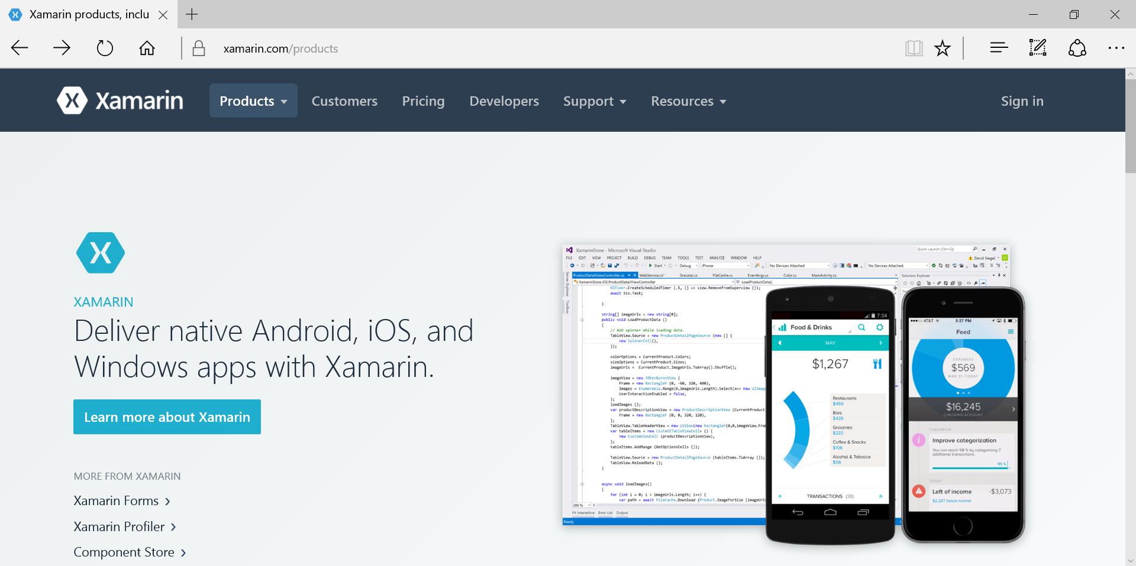
What is Xamarin?
https://www.xamarin.com/products

Slide 5
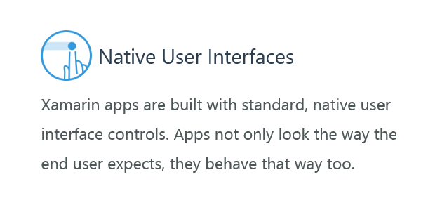
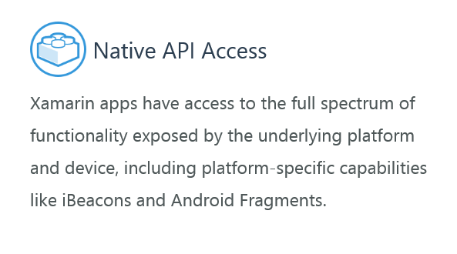
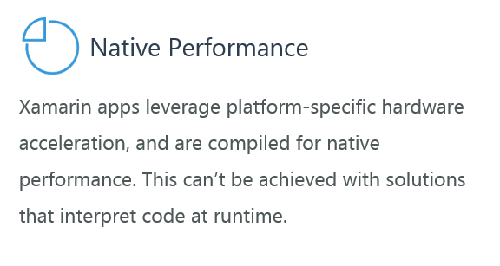
Native?

Slide 6
Short History Lesson
2011 – Xamarin Created
2014 – Xamarin Forms
2016 – Xamarin acquired by Microsoft
2017 – Visual Studio for Mac released
2018 – Xamarin Forms 4 Released

Slide 7

Why Xamarin?
Use a single team
Use a single C# codebase
100% native API access
Native performance
Native user experience
Xamarin is open-source and free

Slide 8

How does Xamarin Work?
Xamarin built on top of Mono
C# Bindings for every API on iOS and Android

Slide 9
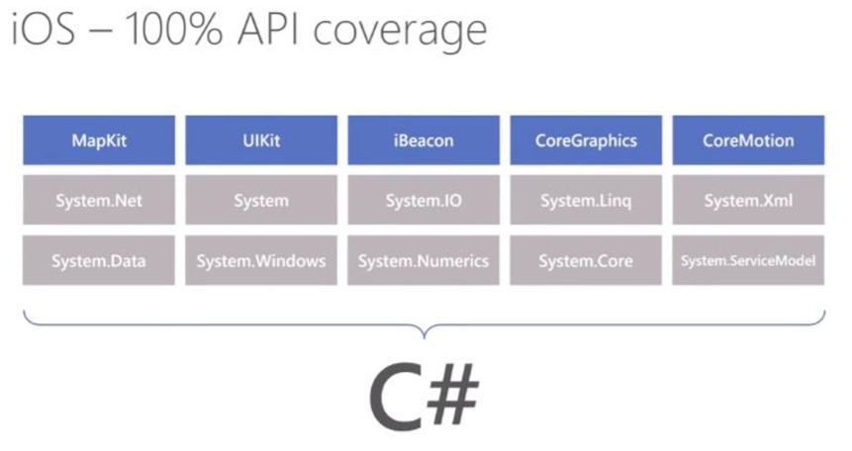
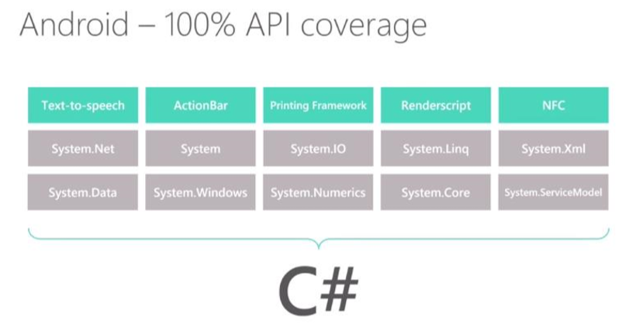
Xamarin Applications are Native
When Xamarin applications are compiled, the result is are native application packages:
iOS = .ipa file
Android = .apk file
These files are indistinguishable from application packages built with the platform’s default IDEs and are deployed in the exact same way

Slide 10
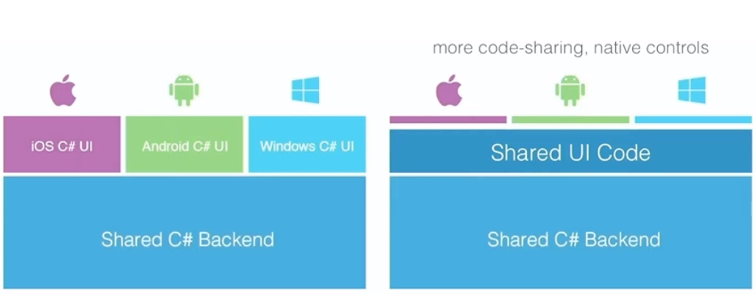
Xamarin vs Xamarin Forms?

Slide 11
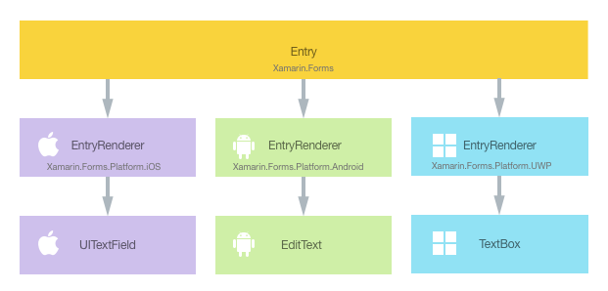
Xamarin Forms – Custom Renderers
Custom Renderers
Effects
Plugins
Dependency Service
Xamarin Essentials
OnPlatform XAML syntax

Slide 12
Demo Time
Pages
ContentPage
MasterDetailPage
NavigationPage
TabbedPage
CarouselPage
TemplatedPage
Layouts
ContentPresenter
ContentView
ScrollView
Frame
TemplatedView
StackLayout
AbsoluteLayout
RelativeLayout
Grid
FlexLayout
Views
Label
Image
BoxView
WebView
OpenGLView
Map
Button
ImageButton
SearchBar
CheckBox
Slider
Stepper
Switch
DatePicker
TimePicker
Entry
Editor
ActivityIndicator
ProgressBar
Views that display collections
CollectionView
ListView
Picker
TableView
Cells
TextCell
ImageCell
SwitchCell
EntryCell
ViewCell
Application Fundamentals
App Class
App Life Cycle
Data Binding
Messaging Center
Navigation
Application Permissions
Manifests
Application Resources
Much more …
Accesibility
Deep Indexing
Behaviors
Gestures
Localization
Shell
Templates
Triggers
Xamarin Essentials
Plugins
Theming
Visual
Visual State Manager
Device Class
Native views
Platform Specifics
Fast Renderers
Effects
Dependency Service
Custom Renderers
Etc.
https://docs.microsoft.com/en-us/xamarin/xamarin-forms/

Slide 13

Thanks for Coming - Links
Github https://github.com/worthingtonjg/Sort2019
Quick Starts https://docs.microsoft.com/en-us/xamarin/get-started/quickstarts/ https://docs.microsoft.com/en-us/xamarin/#pivot=get-started https://docs.microsoft.com/en-us/xamarin/#pivot=xamarin-forms
Learn Xamarin / Xamarin Forms https://dotnet.microsoft.com/learn/xamarin https://dotnet.microsoft.com/apps/xamarin/xamarin-forms
Xamarin Videos https://channel9.msdn.com/Search?term=xamarin&lang-en=true
Git Hub Repositories https://github.com/xamarin/Xamarin.Forms https://github.com/xamarin https://github.com/xamarin/Essentials
Jon Worthington
worthingtonjg@churchofjesuschrist.org
Ext: 25275

